Slide 1

Funny Gorilla诙猩猩-IT培训
Your success is our success
Behaviours Driven Development
BDD

Slide 2
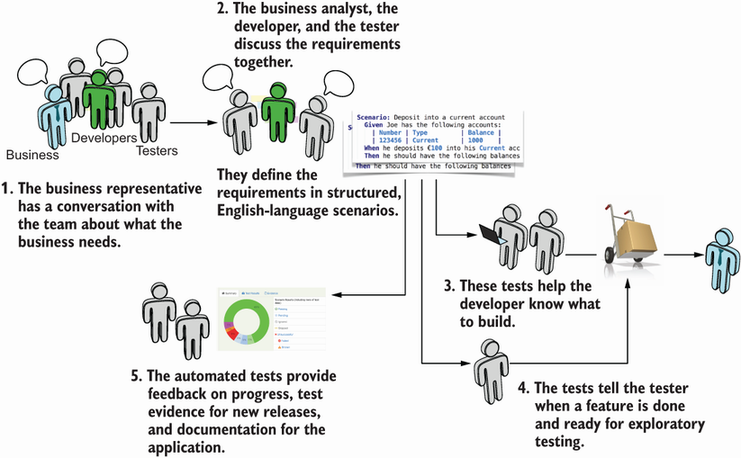

Slide 3
BDD
to provide development and management teams with a shared process and shared tools, so that they can effectively collaborate while developing software.
It extends TDD by writing test cases in a natural language that non-programmers can read.
Users describe features and scenarios to test these features in plain text files using the Gherkin language in the Given, When, and Then structures.
Given: This represents the initial context (precondition)
When: This represents the user performing a key action (actor + action)
Then: This ensures some kind of outcome (observable result)
also known as
acceptance test driven development (ATDD) or
story testing.

Slide 4
Basic Principles of BDD

Slide 5
Follows the basic principle: each unit of software must be individually tested.
The process usually goes like this:
A test is designed for the specific software unit
The test is made to fail
The unit is then implemented into the test
The test is done again, verifying that the implementation of the unit makes it succeed

Slide 6
How it works?
writing a feature file,
implementing automated steps using the step definition file, and
creating support code as needed.

Slide 7
Testing Tools
Cucumber
SpecFlow
Jbehave
Lettuce
etc …

Slide 8
Cucumber introduction
Notes:
Cucumber is an open-source tool.
Plain Text representation makes it easier for non-technical users to understand the scenarios.
It bridges the communication gap between various project stakeholders such as Business Analysts, Developers, and Quality Assurance personnel.
Automation test cases developed using the Cucumber tool are easier to maintain and understand.
Easy to integrate with other tools such as Selenium and Capybara.

Slide 9
Why Cucumber
Cucumber is a tool that uses Behaviour Driven Development to write user acceptance tests of an application. It is used to bridge the communication gap between various project stakeholders.
The main use of Cucumber lies in its simplicity to understand the use of feature files by non-technical users.
Notes:
Cucumber is an open-source tool.
Plain Text representation makes it easier for non-technical users to understand the scenarios.
It bridges the communication gap between various project stakeholders such as Business Analysts, Developers, and Quality Assurance personnel.
Automation test cases developed using the Cucumber tool are easier to maintain and understand.
Easy to integrate with other tools such as Selenium and Capybara.

Slide 10
Writing Test Cases Using Cucumber
Feature file
StepDef file
Runner File

Slide 11
Feature File
Here we write the Features to be tested in Gherkin format i.e. Given When Then.
We can even run the feature file to execute the test scripts written in the Stepdef file.
Given: As mentioned above, given specifies the pre-conditions. It is basically a known state.
When: This is used when some action is to be performed. As in above example, we have seen when the user tries to log in using username and password, it becomes an action.
Then: The expected outcome or result should be placed here. For Instance: verify the login is successful, successful page navigation.
Background: Whenever any step is required to perform in each scenario then those steps need to be placed in Background. For Instance: If a user needs to clear database before each scenario then those steps can be put in a background.
And: And is used to combine two or more same type of action

Slide 12
Feature File
Here we write the Features to be tested in Gherkin format i.e. Given When Then.
We can even run the feature file to execute the test scripts written in the Stepdef file.

Slide 13
StepDef File
Once the Feature file is ready, each sentence of the Feature file can be further implemented over the StepDef file.

Slide 14
Runner File
This is just to execute the actual test script written over the Stepdef file by referring to the feature file.
other options for customization, reporting, selective execution, etc.

Slide 15
Integrate with Selenium

Slide 16
References
https://www.softwaretestinghelp.com/cucumber-bdd-tool-selenium-tutorial-30/
https://www.softwaretestinghelp.com/cucumber-bdd-tutorial/

Slide 17
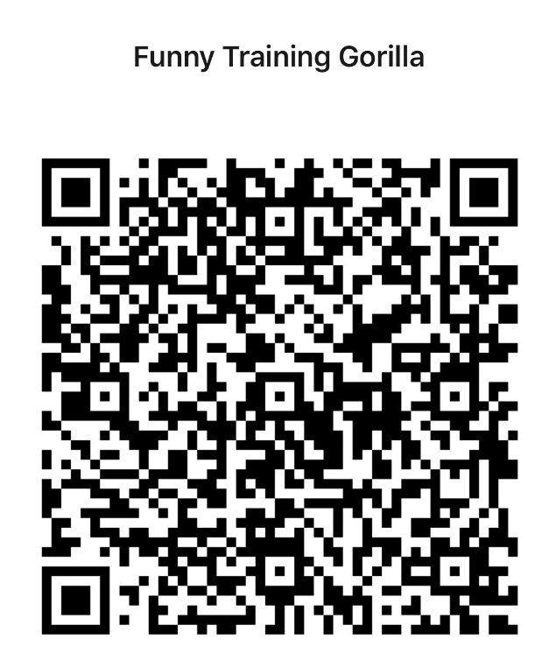
Contact
WebSite: www.funnygorilla.com.au
Mail: info@funnygorilla.com.au
Linkedin: https://mt.linkedin.com/in/songqing-gu-2ba9034b/de
WebChat: Funny Training Gorilla
Phone: 0420891343

